Slide 1
Text Vectorization
Transforming text for analysis

Slide 2
Preparing Data for Machine Learning
Most machine learning algorithms require data to be structured in a two-dimensional array-like structure where:
Columns are features
Rows are instances
Blocks of text must be transformed before analytics can be executed
Bag of Words Approaches (most common)
Each word or stem is considered a feature
Features can be structured as numeric vectors
Each instance would have its own vector of features

Slide 3
Frequency Vectors
Vector contains the feature count in each instance (document)
Counts are either usually
Actual counts of each feature (word) in an instance (document)
Weighted value for each feature based on number of features in the document
Pros
Very easy to calculate
Shows which features are most prominent in a document
Cons
Documents of different length are often not comparable

Slide 4
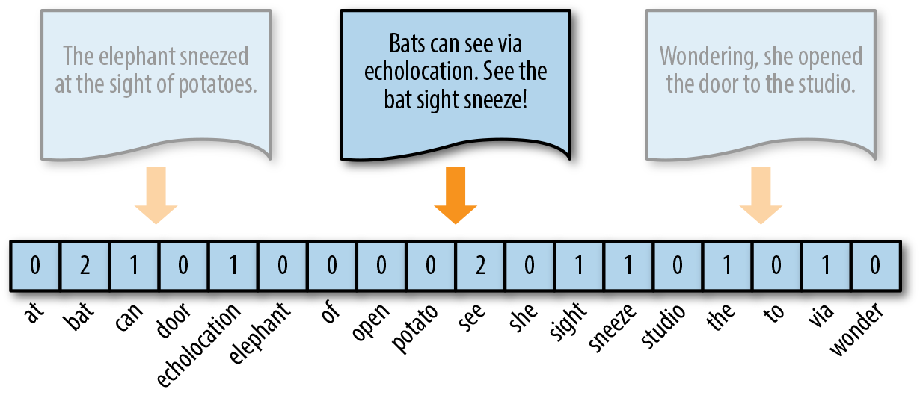
Frequency Vectors

Slide 5
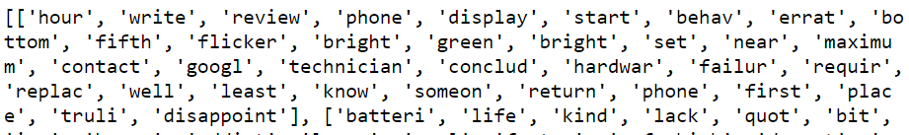
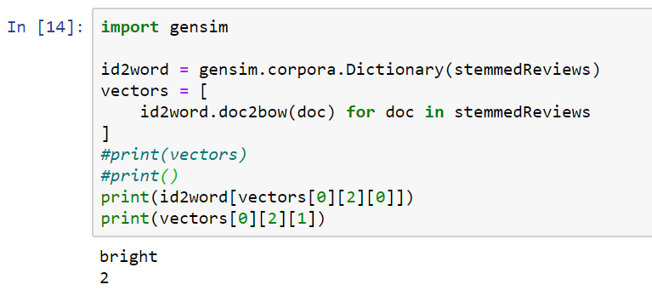
Frequency Vectors in Gensim

Slide 6
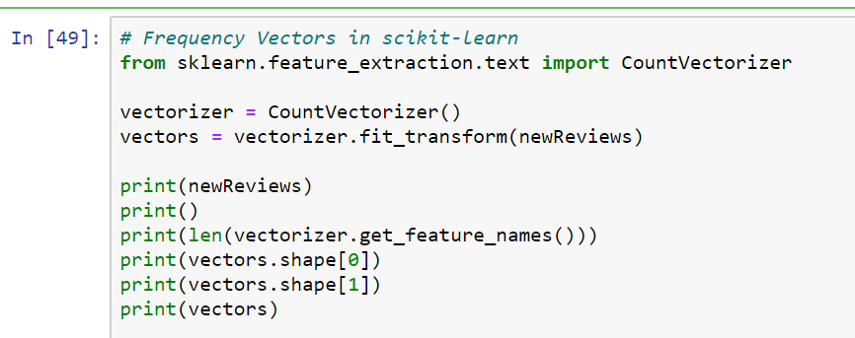
Frequency Vectors in Scikit-Learn

Slide 7
One-Hot Encoding
Boolean approach
Each feature in the vector is marked with
0 if feature does not exist in the instance
1 if the feature does exist in the instance (it does not matter many times the word is repeated, it will give 1 if there is that word)
Eliminates the ‘long tail distribution’ of features that may be common in a single instance
Common when
Instance documents are short
Input is required for Artificial Neural Networks

Slide 8
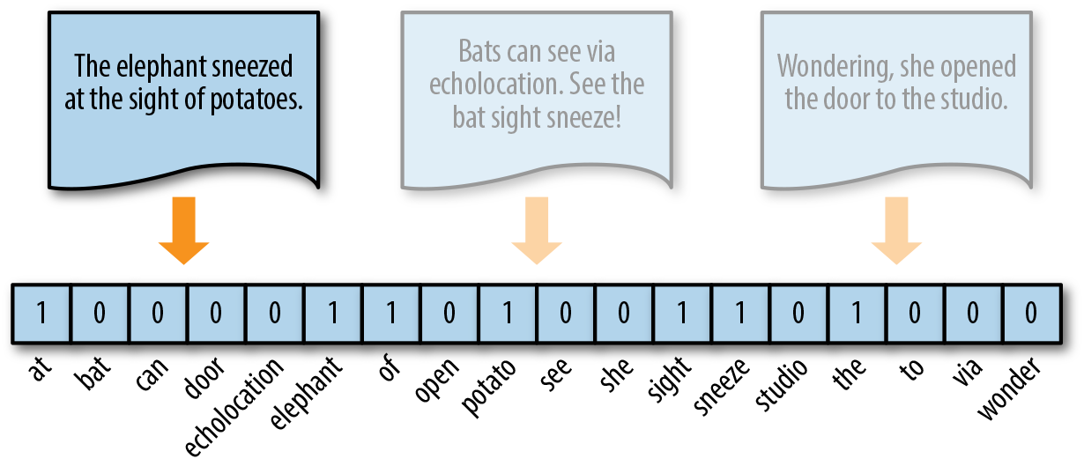
One-Hot Encoding

Slide 9
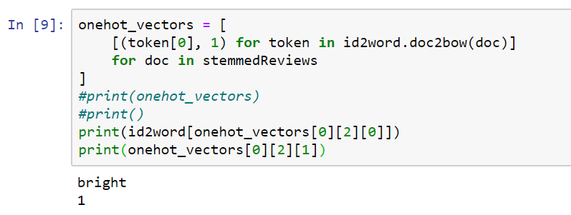
One-Hot Encoding in Gensim

Slide 10
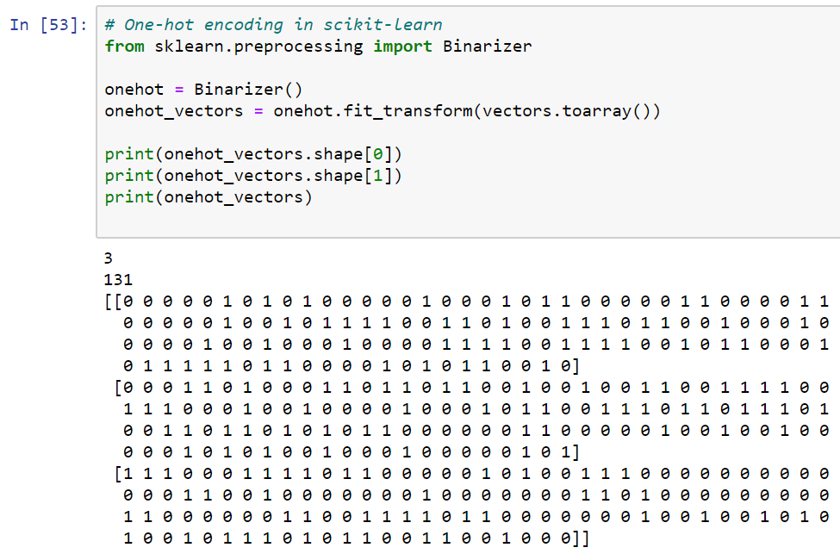
One-Hot Encoding in Scikit-Learn

Slide 11
Term Freq / Inverse Document Freq (TF-IDF)
Introduces features from other documents in the corpus
Calculated feature by feature and document by document
Highlights the features that are
Common in a document
Unique to that document
Pros
Allows comparisons to other documents
Cons
More complex calculation
Can be very intensive with large documents and large corpus

Slide 12

TF-IDF
Term Frequency / Inverse document Frequency
A ratio of:
How often a word occurs in a document
How many other documents in the corpus also contain that word
Inverse Document Frequency IDF =
Where
D = all documents on corpus
|D| = Size of corpus
t = term
d = individual document
Term Frequency
TF = tf(t,d) Where t = term d=document

Slide 13
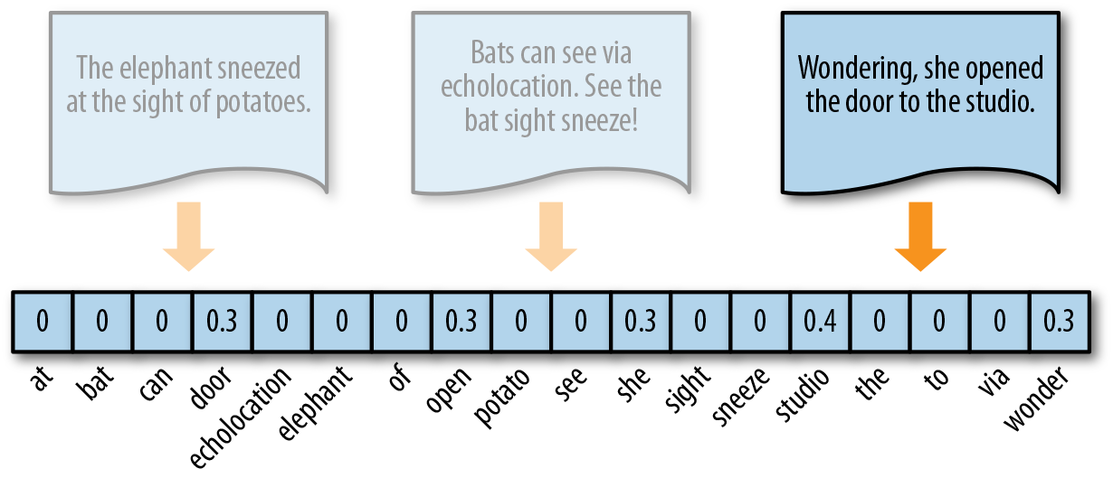
TF=IDF

Slide 14
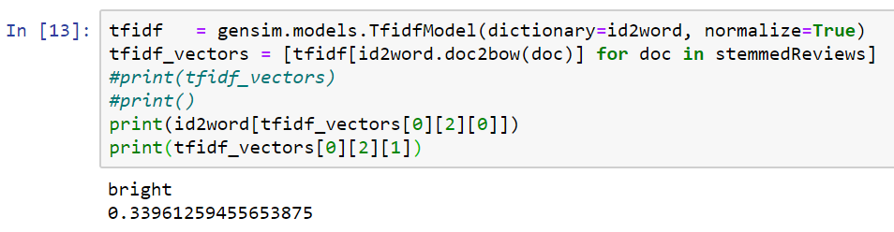
TF-IDF in Gensim
Values close to 1 indicate features that are influential to the characteristic nature of a document
Values close to 0 indicate features that are NOT influential to the characteristic nature of a document
Question: What about stopwords?

Slide 15
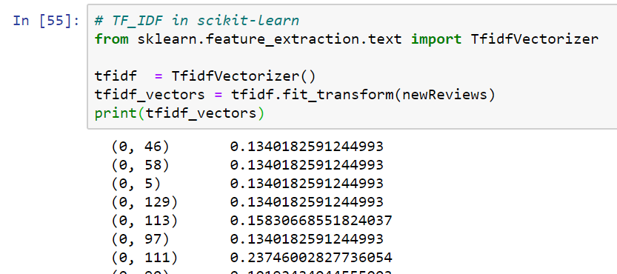
TF-IDF in Scikit-Learn

Slide 16
Document Similarity
Use a distribution of features along a continuous scale
The idea is to find concepts in documents that are semantically similar
Example
BAR could either be a place to drink or a law exam
We can’t just group together documents that have the word BAR
We need to differentiate the usage of the word using other words that define context
Large corpus can be trained to create a model of semantic similarity

Slide 17
Word2Vec in Gensim
This is one of the reasons that I love Gensim, since NLTK and scikit-learn do not support this.
Gensim has a pre-trained model available that you can use
Based on Google News articles
3 million word vocalbulary
100 billion word training set
300 dimensional feature space
1.5 GB in size
Use if your corpus is
Too small to be a training set
Representative of typical use of terms without domain-specific language

Slide 18
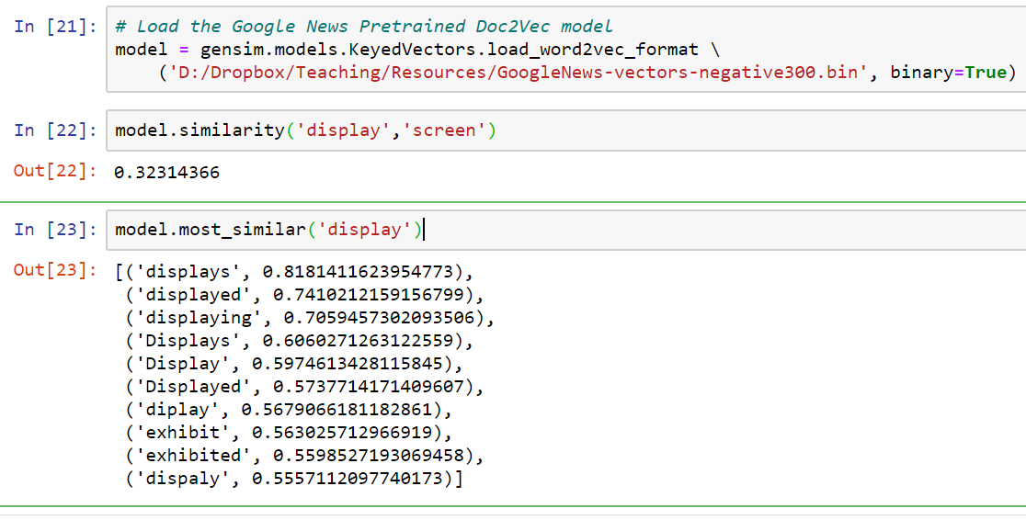
Word2Vec in Gensim

Slide 19
More about Sci-kit-Learn
Most of the machine learning tasks use a component called an Estimator
fit() method does the work of fitting a model based on the training data
predict() method predicts a new value based on new data provided to a fitted model
Transformations can be added to an estimator for special processing requirements
For example, transformers can
lower case
remove stopwords
stem words
etc.

Slide 20
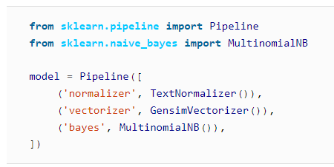
Pipelines
Scikit-learn allows you to combine multiple activities into a single pipeline
Simplifies process definition
Creates an easily repeatable process
We will illustrate pipelines in the next two discussions

